Slide 1
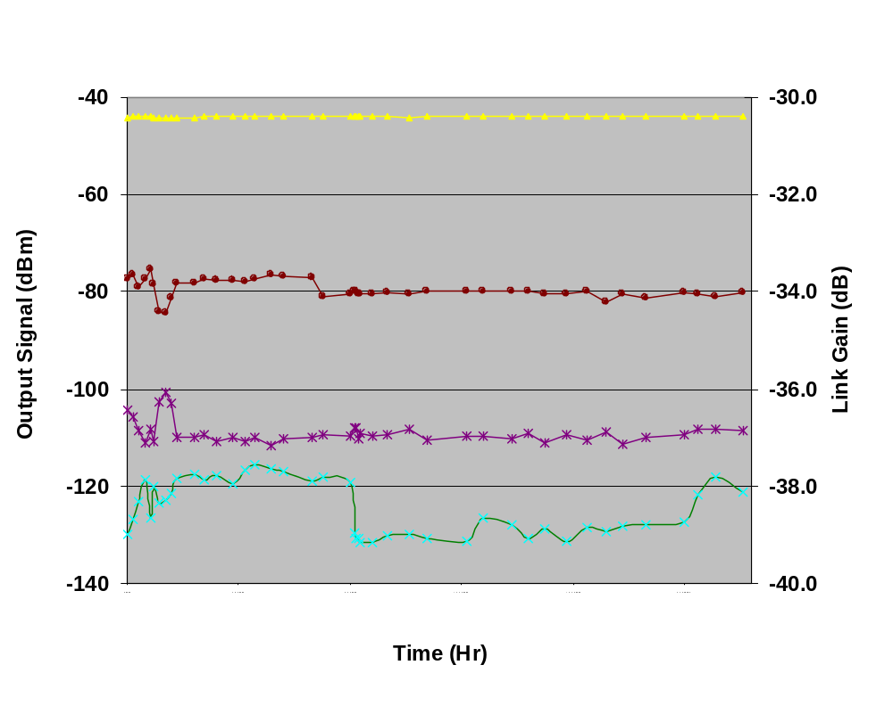
Measured Signal and Intermod Powers, and Calculated gain of Fiber-Optical Link #1 over 4 Month Period
Fundamental Frequency
Link Gain
2nd order distortion
3rd order distortion
0
480
960
1440
1920
2400
Major adjustments done to find min. on the 3rd order distortion before starting test
.004V adjustment to Vm after
After 3rd order distortion had
stabilzed

Slide 2
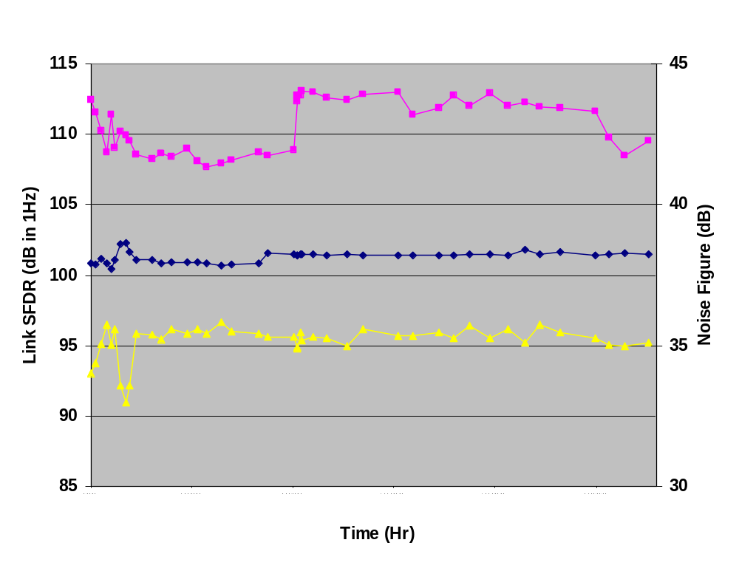
Calculated Noise Figure and Spurious-Free Dynamic Range of Fiber-Optical Link #1 over 4 Month Period
SFDR₃
.004V adjustment to Vm after
After 3rd order distortion had
stabilzed
SFDR₂
0
480
960
1440
1920
2400

Slide 3
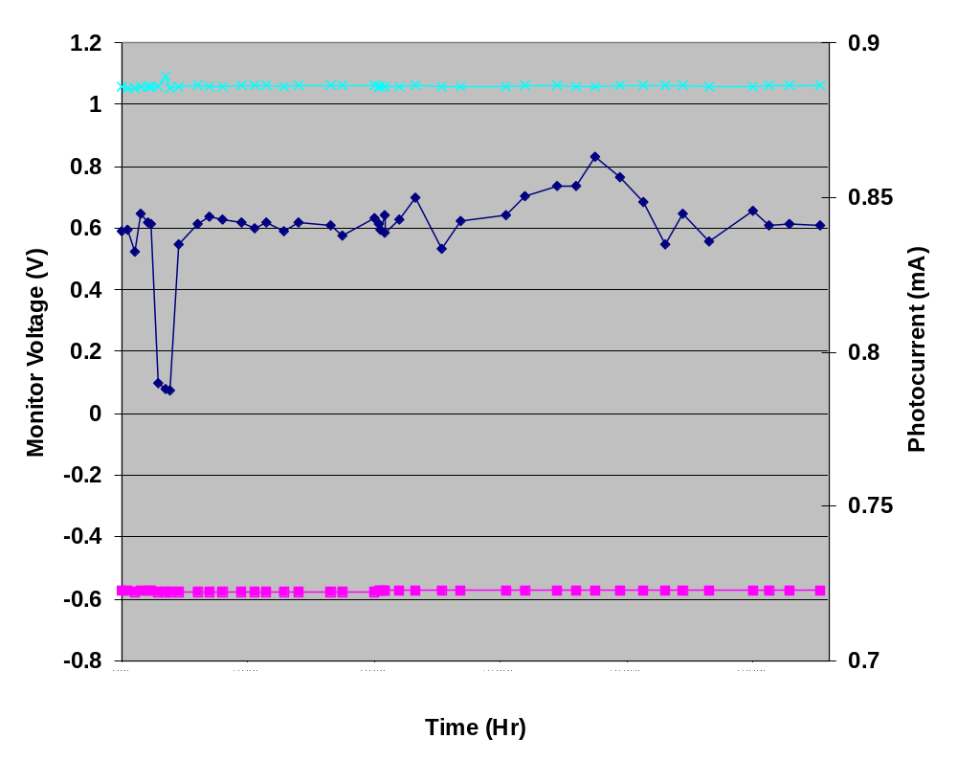
Monitored Voltage and Current Levels in Fiber-Optical Link #1 over 4 Month Period
Optical Voltage Reference
Voltage reference for
Back facet photodiode
Photocurrent
Modulator Voltage
0
480
960
1440
1920
2400
.004V adjustment to Vm

Slide 4
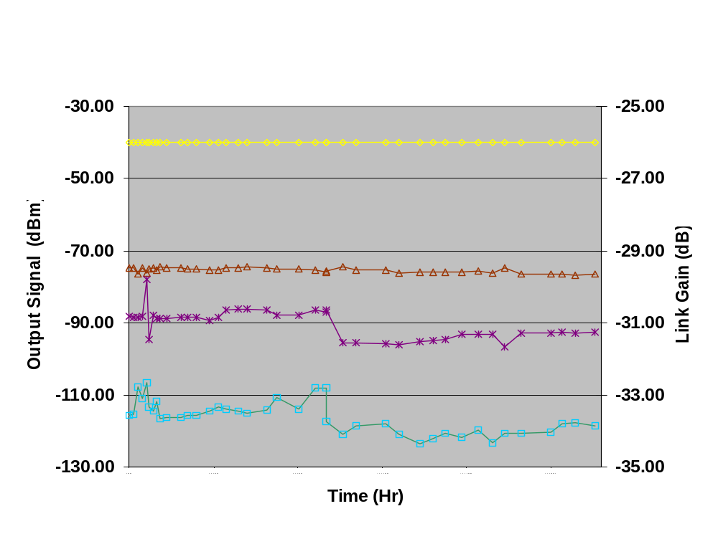
Measured Signal and Intermod Powers, and Calculated gain of Fiber-Optical Link #2 over 4 Month Period
Fundamental Frequency
Link Gain
2nd order distortion
3rd order distortion
0
480
960
1440
1920
2400
Major adjustments done to find min. on the 3rd order distortion before starting test
Power failure in lab: replaced bad
Bias Tee for the modulator section
For the EAM (readjust Vm)

Slide 5
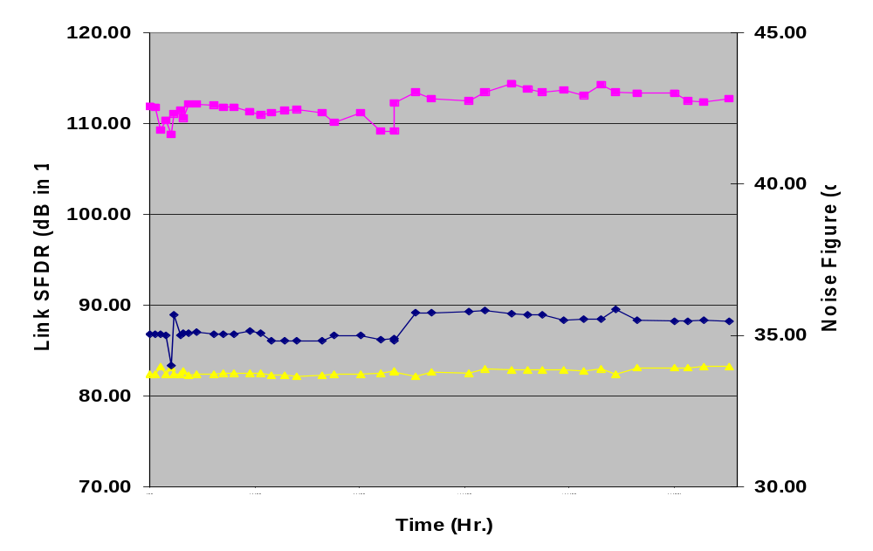
Calculated Noise Figure and Spurious-Free Dynamic Range of Fiber-Optical Link #2 over 4 Month Period
SFDR₃
SFDR₂
0
480
960
1440
1920
2400

Slide 6
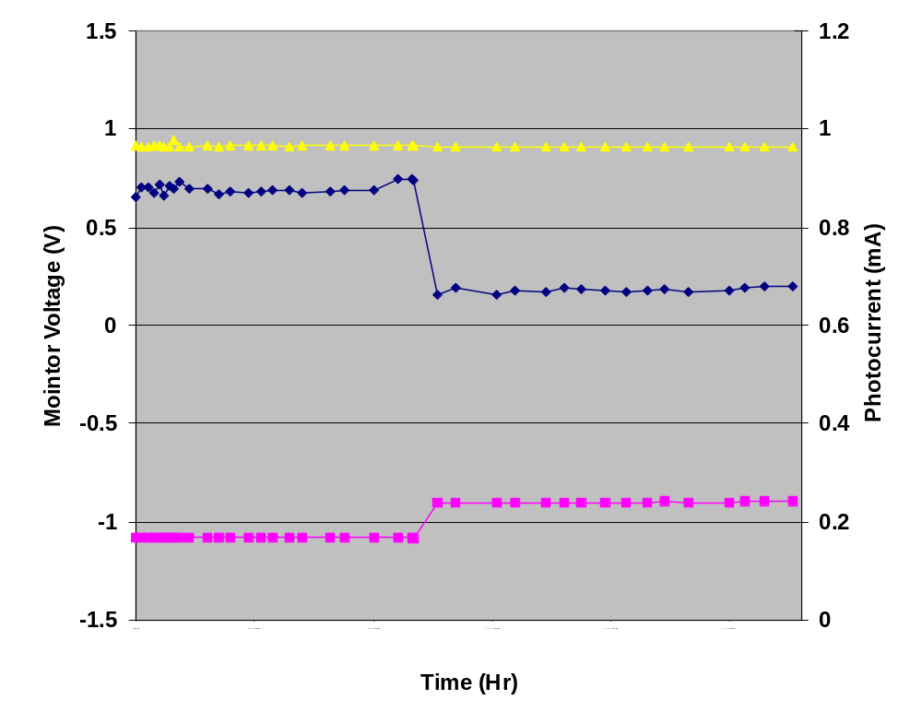
Monitored Voltage and Current Levels in
Fiber-Optical Link #2 over 4 Month Period
Optical Voltage Reference
Photocurrent
Power failure in lab: replaced bad
Bias Tee for the modulator section
For the EAM (readjust Vm)
Modulator Voltage
0
480
960
1440
1920
2400
ΔVm = .189V (bad Bias Tee)

